Slide 1


Prediction Deposito Using Supervised Learning
Machine Learning - Sekolah Data Pacmann
pacmann.io
© 2022 – Pacmann AI

Slide 2
Outline
Introduction
Datasets Description
Problem Statements and Goals
Modeling
Evaluation Model
Cross Validation Neural Network
Conclution
Notes
Referensi

Slide 3
Introduction
Notes:
Transisi antar outline

Slide 4
Introduction
In a bank there are several customers who make deposits to the bank. Each customer has different conditions, ranging from age, income and other dependents. The bank has some data on customers who make deposits or not. This bank wants to make a prediction of conditions that cause banks to make deposits or not. Therefore the data science team conducted an analysis using the machine learning method to help the bank make a decision when it wants to find customers who will make deposits.

Slide 5
Datasheets
Notes:
Transisi antar outline

Slide 6
Datasheets
Data input:
Age : Age of Umur Customer. Job : Customer's job. Martial : Status Married, Single, and Divorced. Education : Education owned by the customer.. Default : Have credit or not. Balance : Customer income every month. Housing : Have a mortgage or not. Loan : Have a loan or not. Contact : Contacting customers using telephone or cellular. Day : Last day contacted. Month : Last month contacted. Duration : The duration of the last contact was called. Campaign : The number of contacts made during the campaign.. Pdays : last contact the client based on the campaign. (999 is null) Previous : The number of contacts made before the campaign. Poutcome : Results from previous marketing campaigns.
Output/Target :
y : Customers who make deposits

Slide 7
Problem Statements and Goals
Notes:
Transisi antar outline

Slide 8
Problem Statements
Problem Statement
Objective Question :
What are the characteristics of customers who make deposits?
How About Correlation data between data input and output/target ?
Which is good model for prediction?

Slide 9
Goals
The objectives to be achieved are: 1. Find data that correlates with the output/target by knowing the characteristics of customers based on existing data.
2. Make a model that is effective and can be used for predictions. 3. Facilitate the bank in finding customers and right on target thereby reducing time, costs, and effort.

Slide 10
Eksplorasi Data Analysis
Notes:
Transisi antar outline

Slide 11
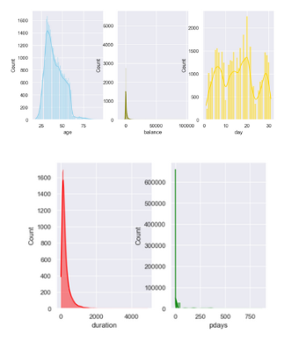
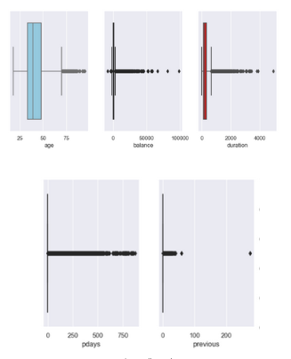
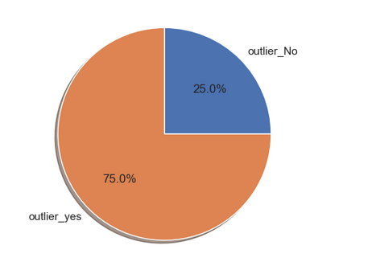
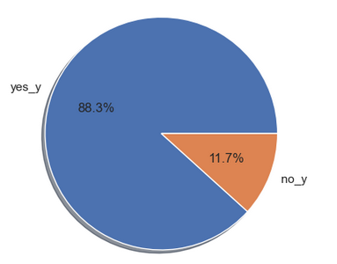
Eksplorasi Data Analysis
Data Cleaning :
Here the outlier data is not discarded but is used to find out whether the outlier data is included in the depositor or not
.(the upper outlier is 16 data while the upper outlier is 0). Then check the median (because of data skew) for each numeric data which is an outlier, then we get: age = 38, balance = 755k, duration = 429.

Slide 12
Eksplorasi Data Analysis
What are the characteristics of customers who make deposits?
New Insight by 'Yes' condition:
Background:
sum of 'yes' condition for job the highest is 'Manajemen'
sum of 'yes' condition for marital the highest is 'married'
sum of 'yes' condition for education the highest is 'secondary’
Tanggungan:
sum of 'yes' condition for default the highest is 'no'
sum of 'yes' condition for housing the highest is 'no'
sum of 'yes' condition for loan the loan is ‘no’
Kontak:
sum of 'yes' condition for contact the contact is 'celluler'
sum of 'yes' condition for poutcome the poutcome is 'unkown'
sum of 'yes' condition for month the month is 'may'

Slide 13
Eksplorasi Data Analysis
New Insight by 'No' condition:
Background:
sum of 'No' condition for job the highest is 'blue-coller'
sum of 'No' condition for marital the highest is 'married'
sum of 'No' condition for education the highest is 'secondary’
Tanggungan:
sum of 'No' condition for default the highest is 'no'
sum of 'No' condition for housing the highest is 'yes'
sum of 'No' condition for loan the loan is ‘no’
Kontak:
sum of 'No' condition for contact the contact is 'celluler'
sum of 'No' condition for poutcome the poutcome is 'unkown'
sum of 'No' condition for month the month is 'may'

Slide 14
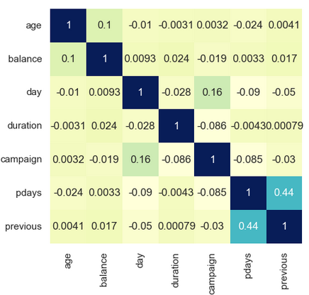
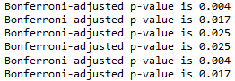
Eksplorasi Data Analysis
Multivariante
How About Correlation data between data input and output/target ?
Bivariant Method
Category VS Category:
Chi-square Method (method Bonferroni-adjusted)
Numeric VS Category :
Duration : 0.32

Slide 15
Modeling
Notes:
Transisi antar outline

Slide 16
Modeling
Feauture Engineering:
Scalling Standarisasi (All model except Random Forest)
SMOTE ( Model Random Forest)

Slide 17
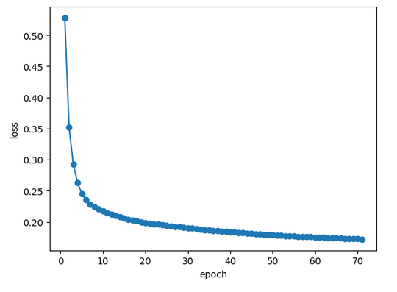
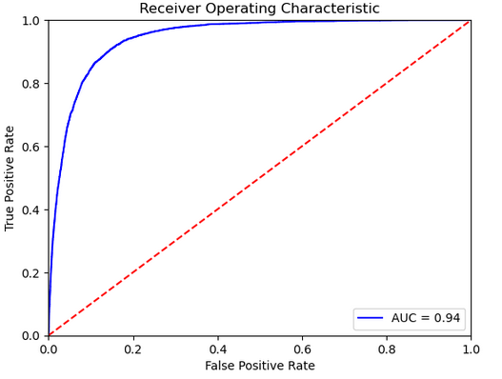
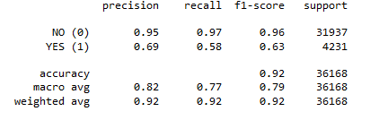
Modeling
Neural Network
Data Train:

Slide 18
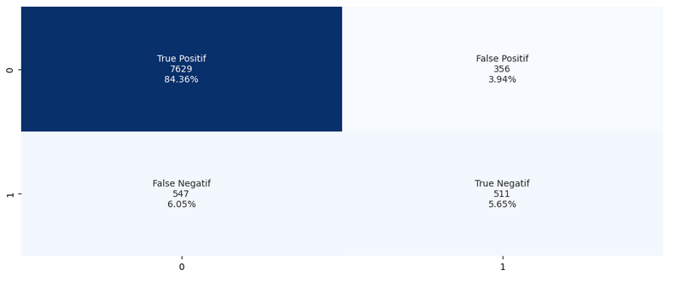
Modeling
Neural Network
Data Train (Confusion Matrix) :
Cross Validation Neural Network
Total of score is [0.92314072 0.9253525 0.93060547 0.9234172 0.92424661 0.92175836 0.93309372 0.92507603 0.90293142 0.90376106] Mean of score is 0.9213383105468033

Slide 19
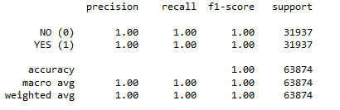
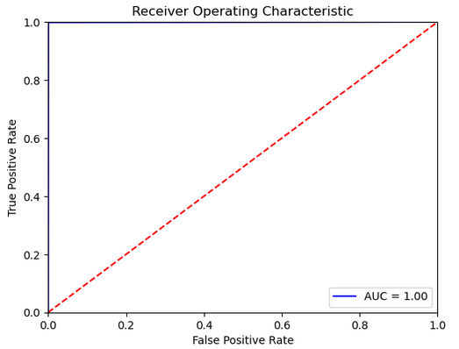
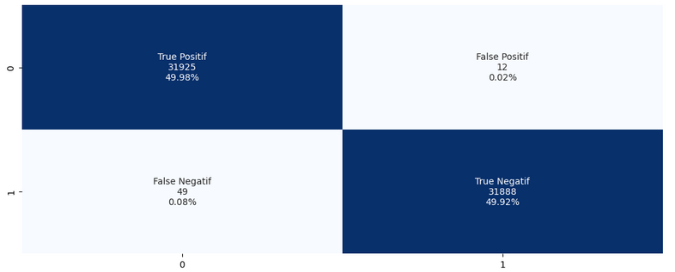
Modeling
Random Forest
Data Train
Cross Validation Adabost
Total of score is [0.89134642 0.87918164 0.88609345 0.88719934 0.88885817 0.88498756 0.89245231 0.89438761 0.89574115 0.89518805] Mean of score is 0.8895435700636863

Slide 20
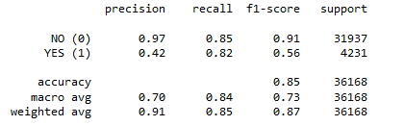
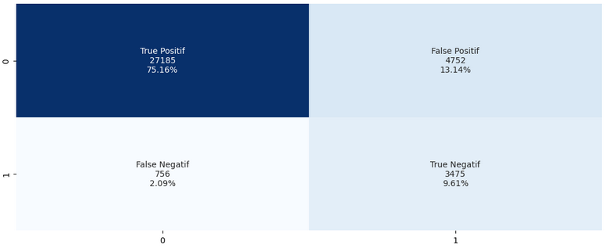
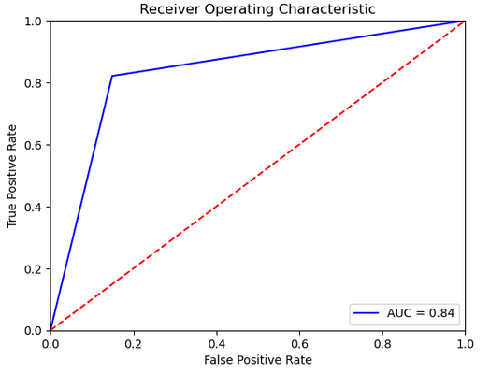
Modeling
Logistic Regression
Data Train
Cross Validation Adabost
Total of score is [0.84213437 0.84628145 0.8556815 0.84324025 0.8457285 0.85208737 0.84517556 0.84019906 0.84928097 0.84928097] Mean of score is 0.8469090008832432

Slide 21
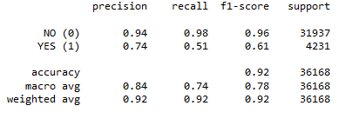
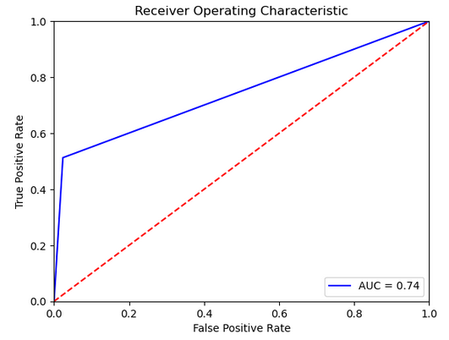
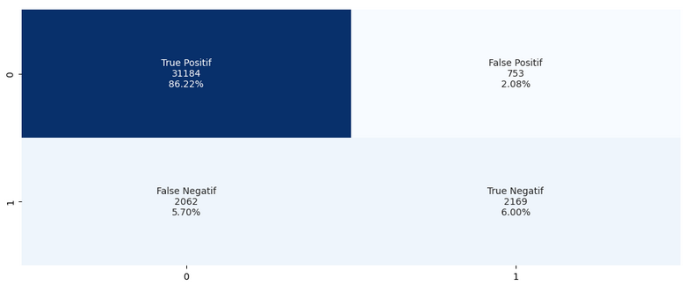
Modeling
Adabost
Data Train
Cross Validation Adabost
Total of score is [0.89438761 0.89798175 0.90821122 0.90572297 0.89964059 0.89991706 0.90793475 0.90074647 0.90154867 0.90597345] Mean of score is 0.9022064562378738

Slide 22
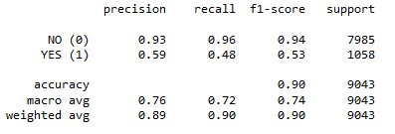
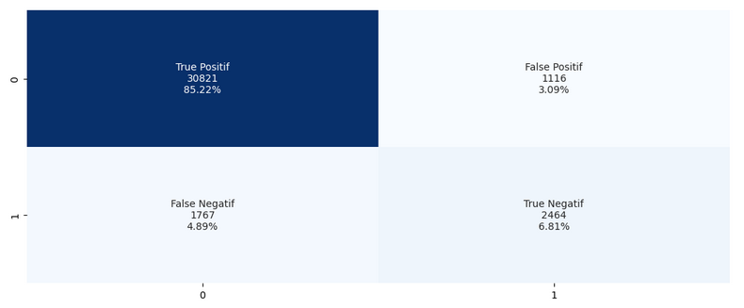
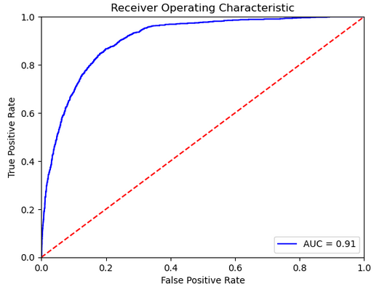
Data Test
We choose model Neural Network Because The model have ROC AUC the highest and data train and test not overfitting
Data Test:

Slide 23
Evaluation
Notes:
Transisi antar outline

Slide 24
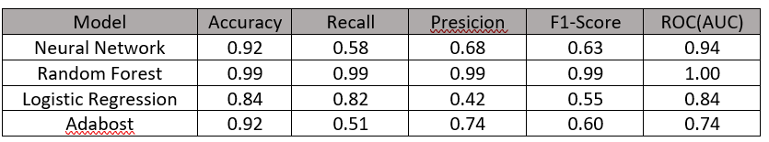

Evaluation (True Positif Rate (TPR))
Data Train :
Data Test :

Slide 25
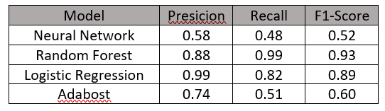
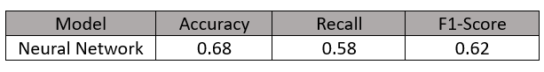
Evaluation (True Negatif Rate (TNR))
Data Train :
Data Test :

Slide 26
Evaluation
Which is good model for prediction?
From the table above, the model that is highly not recommended is the Random Forest model due to the 1 : 0.88 overfitting model. The Logistic regression model has the highest recall metrics compared to other models and the AUC ROC is quite good 0.85:0.84 but has not been able to pass the baseline output so this model is not recommended. The Adabost model is close to a good model but like the logistic regression model it has a low ROC AUC so this model is not recommended. Neural Network Model (Deep Learning) The best model compared to the other three models Because the AUC ROC is 94:91 which has passed the baseline and is not overfitting, why does it have to be AUC ROC? ROC AUC measures how well a model distinguishes between positive and negative instances by depicting the trade-off between False Positive Rate (FPR) and True Positive Rate (TPR) and is well suited for imbalance data. In addition, due to imbalance data, it is necessary to pay attention to the F1-Scores True Positive Rate (TPR) metric and this model has a positive F1-score output of 0.63 : 0.63 because precision and recall are important to consider in distinguishing positive and negative class instances. In addition, because the negative class is "Yes" output data, it is necessary to increase the negative Recall class with the formula TN/(TN+FN) and put it at 0.48 : 0.58 but it is necessary to know if the imbalance data still prioritizes the F1-score, at TNR (True Negative Rate) of 0.52 : 0.62. Next, cross validation will be carried out on the Neural Network model (only the best model).

Slide 27
Conclution
Notes:
Transisi antar outline

Slide 28
Conclution
The highest correlation in numerical data is 'Duration' of 0.343.
The category input data has a p-value below 0.05 with the output data so that the category data are correlated with each other.
The correlation between input and output data affects the results of the modeling used, the more uncorrelated the lower the model value.
The Neural Network Model is the best model in this experiment because this model uses deep learning so it can be better for increasing ROC AUC than the other three models.
Nueral Network Model, TPR 'NO' Output gets an F1-Score of 0.63 : 0.63 while the TNR 'YES' output gets an F1-Score of 0.52 : 0.63.
Hyperparameters determine the model's overfitting, underfitting, and metrics values.
Imbalance data does not always use SMOTE or other methods that turn data into a balance, this is related to model compatibility, there are several models that are more suitable for solving imbalanced data without balance or vice versa.
Not all models require a scaling process like the Random Forest model because they do not require the input data to have a normal distribution or have the same scale.
Learning rate and batch size in training play a big role in the neural network model, the faster the learning rate and the more batch size it causes overfitting.
Imbalance data needs to focus on the ROC AUC because it can distinguish between positive and negative instances.

Slide 29
Notes
Notes:
Transisi antar outline

Slide 30
Notes
This best model (neural network) needs to be improved such as adding several hyperparameters to increase the TNR Recall metrics and can also improve the logistic regression model because the recall value is quite high but the ROC AUC cannot pass the baseline. It is necessary to lower the percentage of FN and increase the TN so that the metrics value on TNR can be high.

Slide 31
Referensi
Yuelin Wanga, dkk. A Comparative Assessment of Credit Risk Model Based on Machine Learning. 174 (2020) 141–149
Premkumar Borugadda. Predicting the Success of Bank Telemarketing for Selling Long-term Deposits: An Application of Machine Learning Algorithms.
Yogesh Sanjay Golecha. Analyzing Term Deposits in Banking Sector by Performing Predictive Analysis Using Multiple Machine Learning Techniques.
Muhammed J. A. Patwary1, dkk. Bank Deposit Prediction Using Ensemble Learning.
A. Motwani. Predicting Credit Worthiness of Bank Customer with Machine Learning Over Cloud.E-ISSN: 2347–2693.

Slide 32
Thankyou ^_^
Notes:
Transisi antar outline

